Slide 1
Understanding Gaps in the HIV Treatment Cascade in 11 West African Countries: Findings from the Regional Community Treatment Observatory
W. Mosime¹, G. Oberth², S. Baptiste¹, A. Manouan¹, P. Garcia¹, T. Taro¹, O.B.K. Gueye¹, A.M. Traore¹ & R. Boka¹
¹ International Treatment Preparedness Coalition (ITPC). West Africa Team in Abidjan, Côte d’Ivoire. Global Team in New York, Gaborone and Johannesburg
² AIDS and Society Research Unit (ASRU), Centre for Social Science Research (CSSR), University of Cape Town (UCT), Cape Town South Africa
10th IAS Conference on HIV Science (IAS 2019)
July 2019, Mexico City
Session Code: | TUPDB01
Session Title: | Chasing waterfalls: Cascades of care
Session Date: | Tuesday, 23 July 2019
Session Time: | 13:00-14:00
Session Room: | Palacio de Iturbide 1 y 2 (SR4)

Slide 2
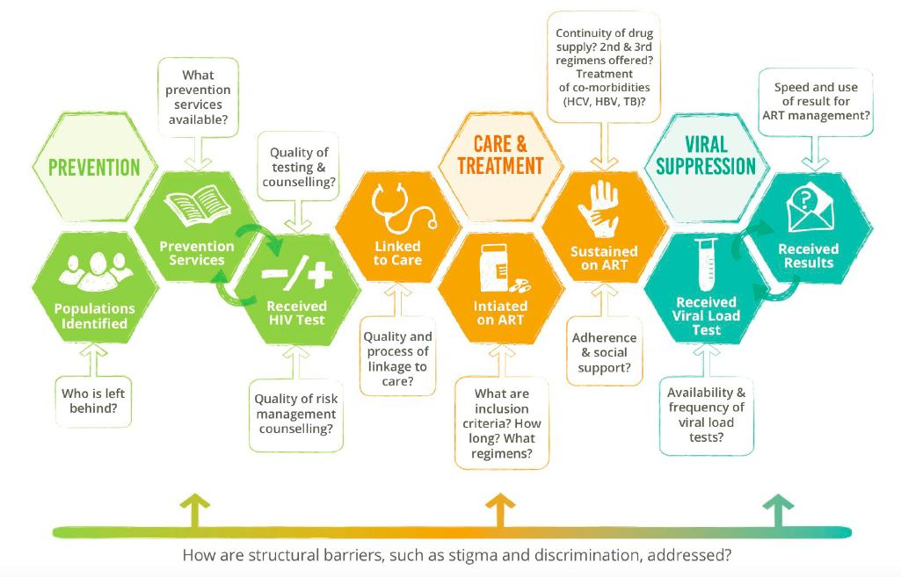

Slide 3
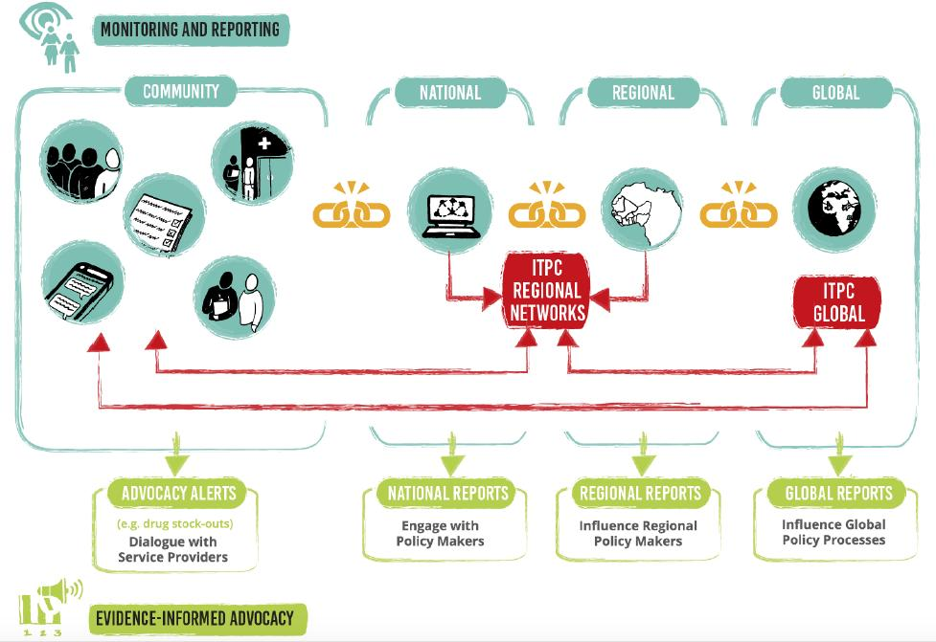

Slide 5
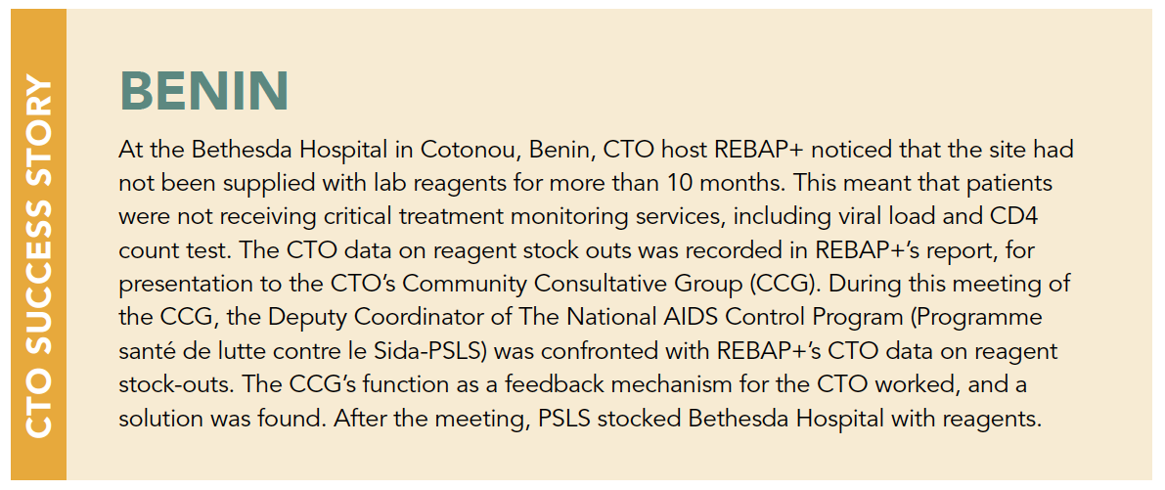
Case study 1: Using data to alleviate stockouts

Slide 6
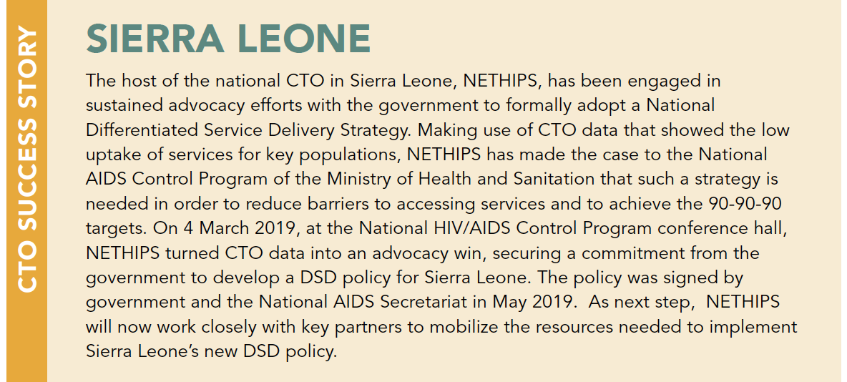
Case Study 2: Using data to improve policy-making

Slide 7
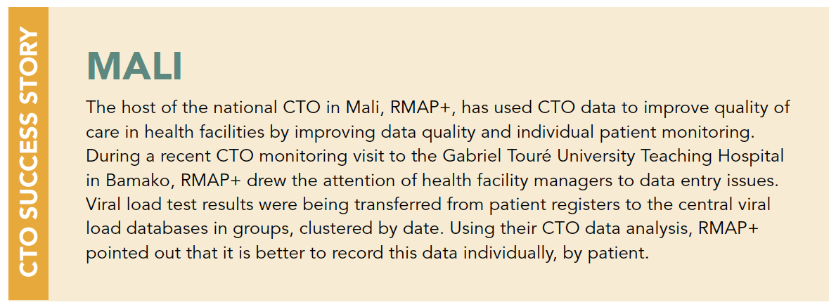
Case Study 3: Using data to improve quality of care

Slide 8

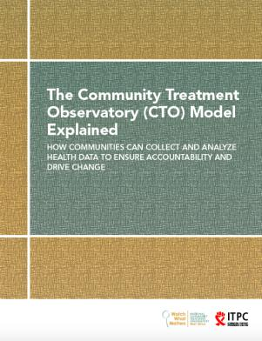

RCTO-WA Resources – For Further Learning
Read about the RCTO-WA’s Baseline Study conducted in June-July 2017. The report identifies five key barriers to access of HIV, prevention, care, and treatment services and offers critical insights on the role of community monitoring in addressing these barriers.
Read ITPC’s Implementation Guide for Community Treatment Observatories (CTOs) as a Model for Community-led Monitoring. The guide explains how ITPC’s CTO model works and how it can be replicated or adapted in any context.
This publication is available in English and in French.
Read the RCTO-WA’s Advocacy Paper, which shares the key findings, analysis and advocacy opportunities emanating from the project. The paper contains 14 data-driven advocacy alerts, with clear calls to actions for communities, governments, donors and other key stakeholders in the West African region.

Slide 9
Thank You!
ITPC GLOBAL
SOUTH AFRICA
104 Oxford Road, Houghton Estate
Rosebank, Johannesburg
2198, Republic of South Africa
ITPC WEST AFRICA
CÔTE D’IVOIRE
Abidjan Cocody angre 7th slice
+225 22 52 99 89
infos@itpcwa.org

